Slide 1
HOW TO UNINSTALL A SOFTWARE FROM A COMPUTER?
Instructor: Ms. Hafsa Zahra
Date:23-03-2020

Slide 2
Software un-installation
Computer users who have unwillingly installed a program, can easily uninstall it using built in Windows features.
PC users should know that nowadays, Internet is flooded with various potentially unwanted applications which install together with free software or through deceptive online banner ads.

Slide 3
Software un-installation
Most commonly software that install without user's consent cause unwanted ads, slows down user's operating system and can lead to privacy and security issues.
To avoid installation of potentially unwanted programs, internet users are advised to only install software that they trust and be very attentive when downloading freeware.

Slide 4

To uninstall a program from Windows xp :
1. Navigate to the Windows start menu by clicking on the "Start" button.

Slide 5
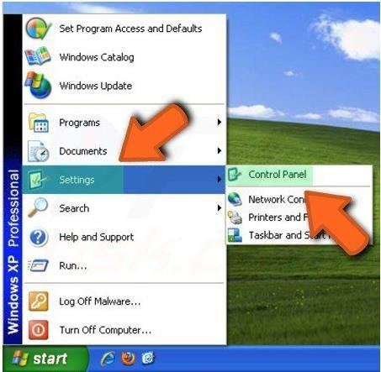
To uninstall a program from Windows XP:
2. When the Start Menu opens select "Settings", then click on "Control Panel".

Slide 6
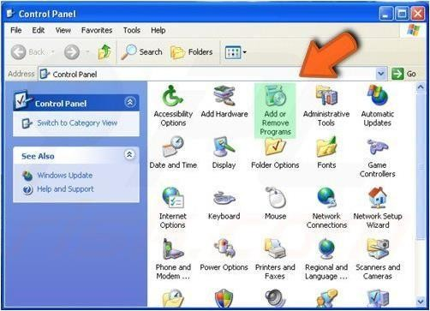
To uninstall A program from Windows XP:
3. In the Control Panel window click on the "Add or Remove Programs".

Slide 7
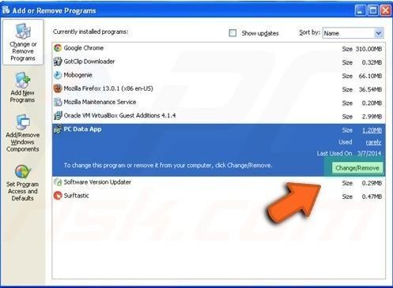
To uninstall a program from Windows XP:
4. In the "Add or Remove Programs" window select the program you want to uninstall and click in the "Change/Remove" button.

Slide 8
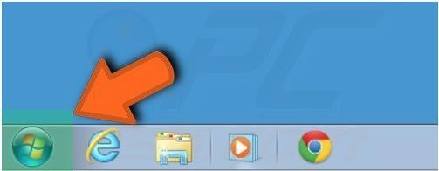
To uninstall a program from Windows 7 :
1. Navigate to the Windows start menu by clicking on the Windows logo (Start) button.

Slide 9
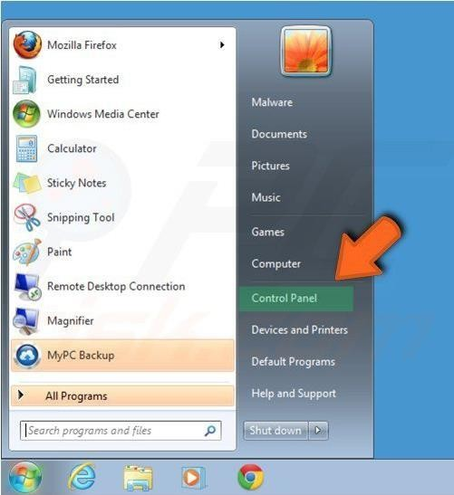
Touninstall a program from Windows 7:
2. When the Start Menu opens select "Control Panel".

Slide 10
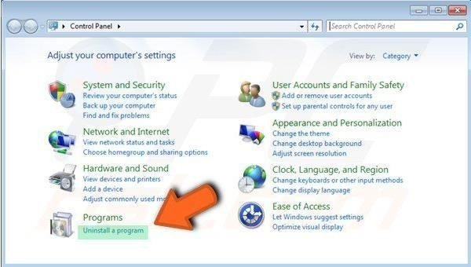
Touninstall a program from Windows 7:
3. Depending on your view options either click on:
"uninstall a program" or "program and features".

Slide 11
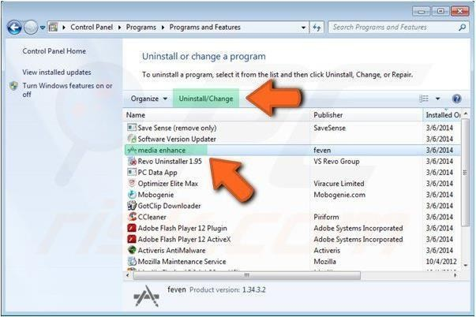
Touninstall a program from Windows 7:
4. When the programs and features window opens select the program your want to uninstall from the list and click on the "Uninstall" button.

Slide 12
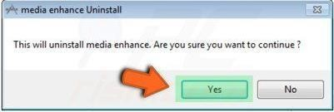
To uninstall a program from Windows 7:
5. Confirm that you want to uninstall a program by clicking on the "Yes" button.

Slide 13
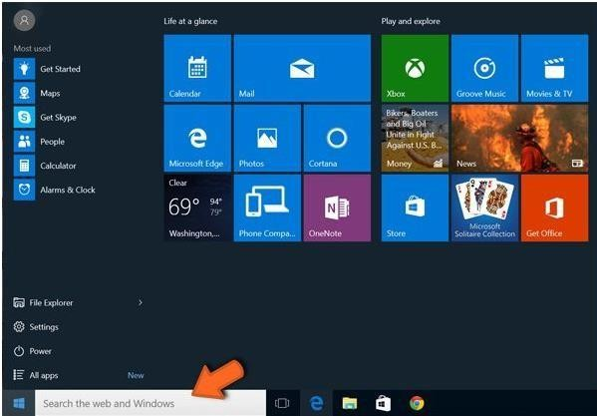
To uninstall a program from Windows 8 and Windows 10:
1. When in the "Start" screen, start typing "Control Panel".

Slide 14
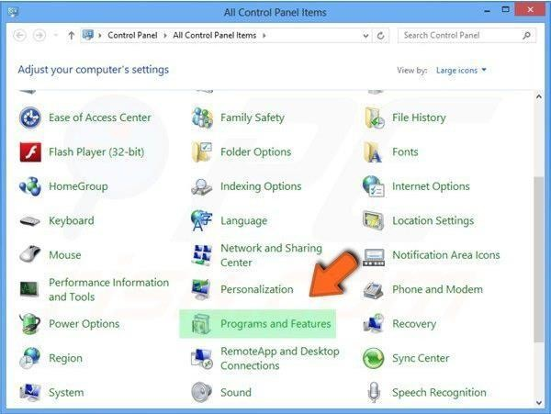
To uninstall a program from Windows 8 and Windows 10:
2. Click on the "Control Panel" from the Apps search results. In the opened window select "Programs and Features".

Slide 15
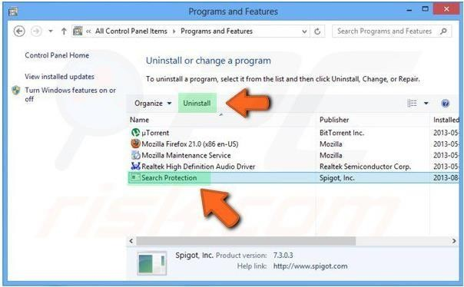
To uninstall a program from Windows 8 and Windows 10:
3. In the Programs and Features window select the program you want to uninstall and click on the "Uninstall" button.

Slide 16
To uninstall a program from Windows 8 and Windows 10:
3. In the Programs and Features window select the program you want to uninstall and click on the "Uninstall" button.

Slide 17
ACTIVITY
To uninstall an unnecessary program from your computer to follow these set of instructions discussed in previous slides.

